Slide 1
TEALS Minecraft Project
Connor Hollasch & Steve Hollasch

Slide 2
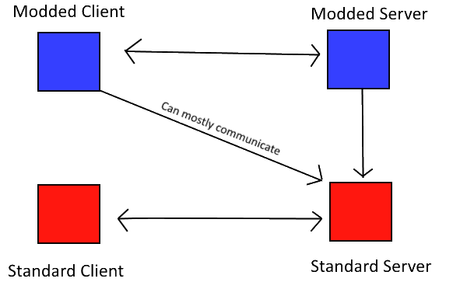
Mods
Server modifications (plugins)
Used on standard client
Modifies current game assets
Client modifications
Create or modify game assets
Only works on servers with the same mod
Notes:
Minecraft has a server-client architecture. Servers host multiple clients. In general, there are many modified servers (some official, some not) that host a variety of multi-user worlds. Clients can be modded, but most servers try to allow only official, unmodified clients.
While it would be great for the classroom to share a single world, that requires a server setup in the classroom—a challenge to implement and a challenge to get the school IT staff to allow. This course uses standalone clients, which keeps things simple.

Slide 3

Implementation
Everything’s Written in Java
A Minecraft world is composed of items, blocks, and entities
items — Objects in the Minecraft world
blocks — Define the world landscape (in a 3D grid)
entities — Players, creatures and robots that move around the world
Notes:
These three items—items, blocks, and entities—are what the Minecraft Modding Project focuses on. Students will create code for each of these three types of objects.

Slide 4
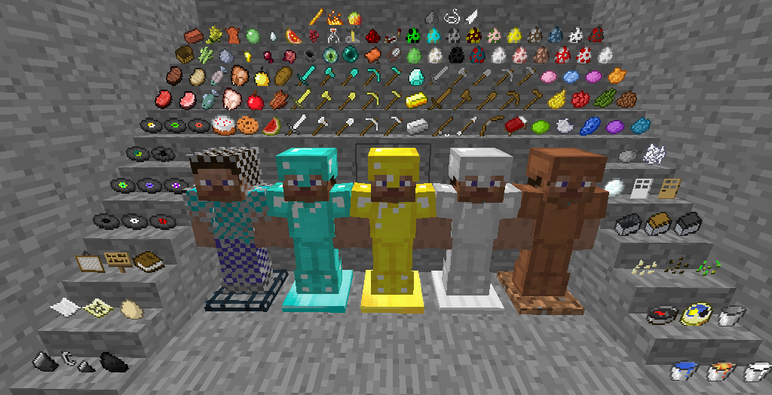
How Minecraft Works – Items
Contained within the world
Players can “carry” items
Types include: food, weapons, armor, tools, or just default item
Can be dropped / picked up in world
Example items include: potato, gunpowder, gold sword, book
Notes:
These are the simplest kind of items. We will start here and spend a single lab on creating new item types.

Slide 5
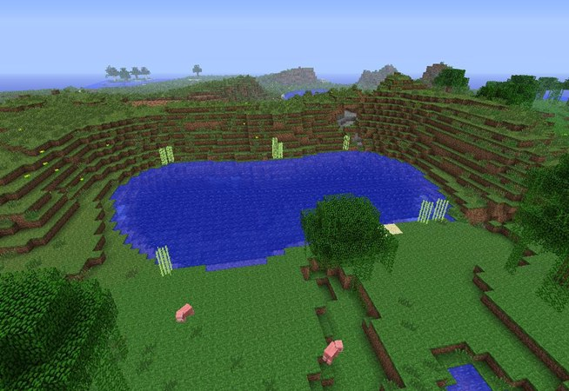
How Minecraft Works - Blocks
The world is made up of blocks
Blocks can be broken or placed
Some items place blocks
Example blocks include: stone, dirt/grass, leaves, wood, grass
Notes:
Blocks are more complicated than items, and allow for greater variety and programming capabilities. Blocks are addressed in three different labs of increasing complexity.

Slide 6
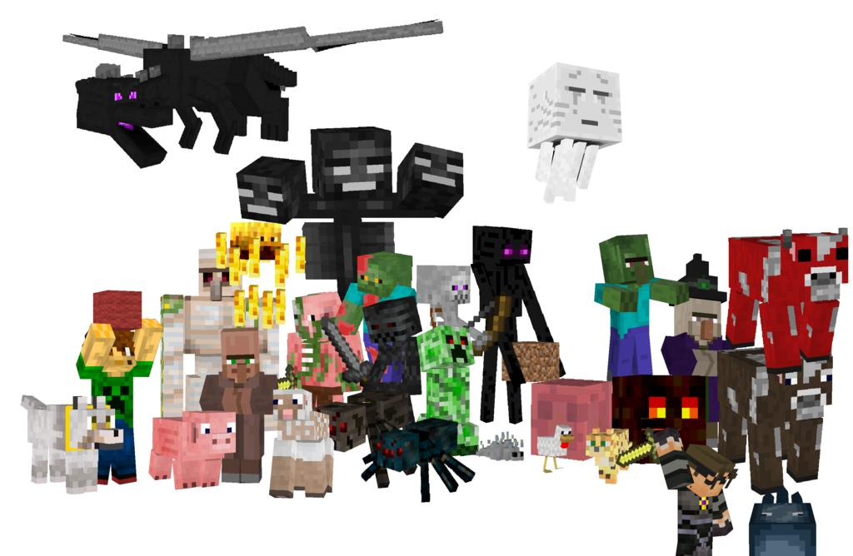
How Minecraft Works – Entities
Entities are placed randomly around the world
Entities have autonomous behaviors
Can be friends, foes or neutral
Entities include: skeleton, sheep, cow, pig, wolf
Notes:
Entities are the most complicated and powerful objects. Entities in this project are all variants of `Robot` entities, which come with a number of useful interfaces. These allow students a lot of flexibility to create cool creatures without getting bogged down in details. Entities are covered in four of the labs.

Slide 7
TEALS Minecraft – Goals
Designed to build on everything your APCS students have learned to date.
Project is hosted publicly on GitHub, so open to bug reporting, examination, contributions, and other project contributions. We can also host a public wiki for further feedback.
Lasts 2–3 weeks. Your actual time will vary.
9 labs total, many more possible. Each lab has summary at the start for the APIs required for that lab, plus multiple phases of implementation for continuing feedback.
Lectures provided in PowerPoint and PDF formats.
Lab solutions and other instructor-only materials available to instructors in the GitHub APCSA repository (/projects/minecraft/).

Slide 8
TEALS Minecraft — Materials
This project uses the Forge modding API
A modding package for clients
Has the ability to mod server, but not implemented for this curriculum
Instructors/Students Distribution
Zip file containing source code
Designed to work on Eclipse or IntelliJ. Other IDEs possible, but that's up to additional developers/instructors/students.
Documentation for lectures, student guides and labs
Single File Setup
Zip file from public GitHub repo,
or as a locally-copied file (about 180MB).

Slide 9
Lab Demo — Tree-Growing Blocks
A quick demonstration of lab 5, where students create “seed” blocks that end up growing different types of trees: cube, sphere, cylinder, and cone.
Notes:
We have a demo script that is fairly simple to set up and run to show this. Source code is available on GitHub in the `apcsa` repository, under `projects/minecraft/demo`.

Slide 10
Contact Info
Connor Hollasch connor@hollasch.net GitHub: chollasch
Steve Hollasch steve@hollasch.net GitHub: hollasch
Main TEALS GitHub Org http://tealsk12.github.io
Teals-Minecraft Web Site http://tealsk12.github.io/teals-minecraft
Teals-Minecraft Instructor Chat on Slack https://tealsk12.slack.com ‘tealsmc’ channel

